Slide 1
Madrid Real Estate
Insights from Data Visualization in Power BI
By: Md Aamir Nawab

Slide 2
Introduction
This presentation analyzes the Madrid real estate market, focusing on the impact of features like pools and gardens, as well as house types and their investment potential.

Slide 3

Objective
The objective of this analysis is to analyze key factors influencing property prices in the Madrid Real Estate Market. The dashboard provides insights into:
Impact of property features (pool, garden, exterior status) on price.
Comparison of new vs. non-new developments and their price variations.
Differences in average price across various house types (Pisos, Chalets, Áticos, etc.).
Distribution of built square meters by house type, identifying the most common property sizes.
This analysis helps buyers, investors, and real estate professionals make data-driven decisions based on property characteristics and market trends.

Slide 4
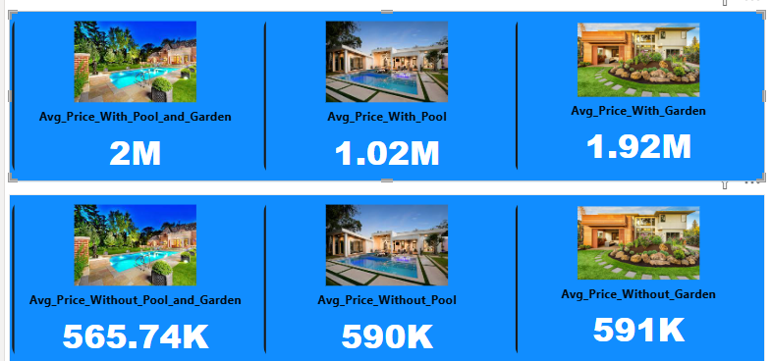
Comparison of average prices with pool and garden
Average Price Comparison Based on Pool and Garden Features
Properties with both a pool and a garden have the highest average price (2M).
Having only a pool results in an average price of 1.02M.
Having only a garden leads to an average price of 1.92M .
Properties without a pool or garden have significantly lower prices (~565K - 591K ), showing that these features add significant value.

Slide 5
Value of features on property pricing
The analysis shows that both pools and gardens add considerable value to properties in Madrid. While having a pool alone results in higher pricing, the combination of both features results in the highest market value. This suggests that buyers are willing to invest more for homes that offer these desirable outdoor amenities.

Slide 6
Impact of external status on pricing
Analysis shows that exterior houses command an average price of 608K, significantly less than non-exterior houses which average 1.01M. This disparity indicates that while exterior features are valuable, internal features and location may influence pricing more, making non-exterior properties often more desirable despite being less visible.

Slide 7
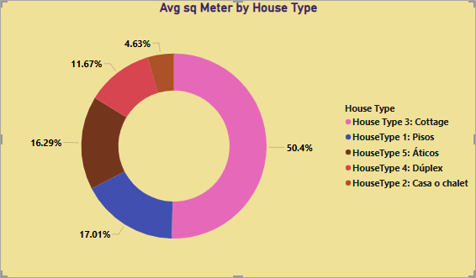
House type distribution by square meters
Insights from the Chart: "Avg sq Meter Price by House Type"
Cottages (House Type 3) have the highest average price per square meter (50.4%), indicating they are the most expensive property type.
Pisos (Apartments) contribute 17.01%, showing that they have a relatively lower price per square meter compared to cottages.
Aticos (16.29%) and Duplex (11.67%) fall in the mid-range category in terms of price per square meter.
Casa o chalet houses (4.63%) have the lowest average price per square meter, making them the most affordable among the given property types.
Key Takeaways:
Cottages are the most expensive per square meter, likely due to location, design, or demand. - Pisos, Duplex, and Áticos have moderate pricing, providing options for different buyer budgets. - Casa o Chalet houses are the most affordable per square meter, which may attract budget-conscious buyers.
This analysis helps homebuyers and investors make informed decisions based on price trends across different house types.

Slide 8
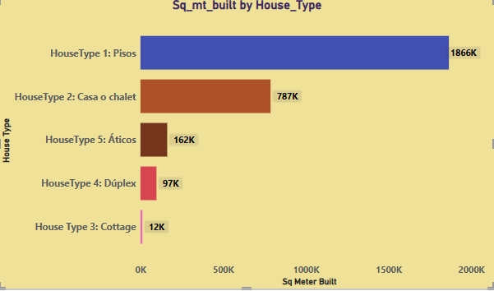
Sq_mt_built by House Type
Insights:
Pisos (Apartments) Dominate the Market
1.86 million square meters of total built area belongs to Pisos (apartments), making them the most common property type in Madrid.
This aligns with urban living preferences, where apartments offer affordability and availability.
Casa o Chalet (Houses) Hold a Significant Share
787K square meters are occupied by Casa o Chalet properties, which suggests a substantial market for individual houses despite apartments being dominant.
Premium Property Types Have Lower Availability
Áticos (Penthouses) cover 162K square meters, and Dúplex properties cover 97K square meters, making them relatively scarce.
These properties are typically considered luxury options, which explains their limited built area.
Cottages Are Extremely Rare
Only 12K square meters are dedicated to Cottages, confirming that they are a niche market segment.
Cottages may be found in rural areas or exclusive zones, catering to a very specific buyer group.
Key Takeaways for Investment:
Apartments are the safest and most scalable investment choice due to their widespread availability.
Investing in Chalets offers strong potential, given their significant presence in the market.
Luxury properties like Penthouses and Duplexes may yield high returns but have limited availability.
Cottages are rare and may cater to a niche market, making them a risky but unique investment option.

Slide 9
Combined Insights from Both Charts: Property Distribution & Built Area
Apartments (Pisos) Dominate Both in Size and Volume
50.4% of the total built area belongs to apartments, making them the most common property type in Madrid.
With 1.86 million sq. meters built, they significantly surpass other house types, reinforcing their popularity in urban settings.
Key Takeaways for Investment:
Apartments (Pisos) are the safest and most liquid investment, given their dominant presence in both area and market share.
Chalets offer significant investment potential, balancing affordability with space, making them appealing for families.
Luxury properties (Penthouses & Duplexes) may provide high returns but are limited in supply, requiring strategic investments.
Cottages are highly exclusive and cater to a niche market, making them risky but unique investment opportunities.
2.Casa o Chalet (Independent Houses) Hold a Strong Market Share
Representing 16.29% of the built area, Chalets cover 787K sq. meters, making them a major investment segment.
These houses offer more space compared to apartments, attracting families and long-term homeowners.
3.Luxury Properties Have Limited Availability
Áticos (Penthouses) and Dúplex properties together account for less than 30% of the market, with only 162K and 97K sq. meters built, respectively.
These property types cater to high-end buyers, making them premium investment opportunities with potentially high returns.
4.Cottages Are the Rarest Property Type
With only 4.63% of the total market share and just 12K sq. meters built, Cottages are extremely limited in availability.
They likely serve a niche audience, mostly in rural or exclusive areas, making them a specialized investment.

Slide 10
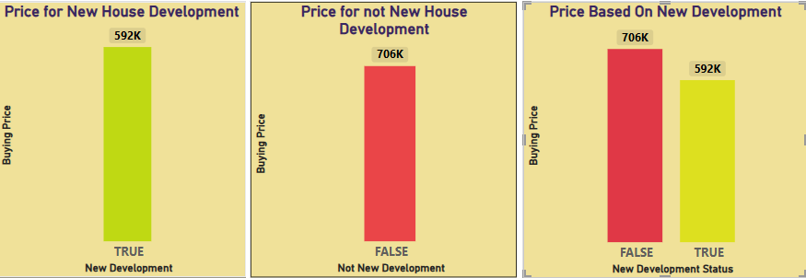
Insights from New Development Price Comparison Charts
New Developments Are More Affordable
The average price of newly developed houses is 592K, while older properties cost 706K on average.
This suggests new houses may be priced lower to attract buyers, possibly due to developer incentives or modern construction efficiencies.
Older Properties Are More Expensive
Houses that are not newly developed have a higher price (706K), which could be due to prime locations, larger plots, or historical value.
Buyers may pay a premium for well-established neighborhoods or properties with unique architectural features.
Potential for Appreciation in New Developments
Since newly developed properties are cheaper, they may offer higher appreciation potential over time.
Buyers looking for long-term investments could benefit from purchasing newer developments at lower prices and selling later at a profit.
Key Takeaways for Buyers & Investors
Investing in new developments can be a cost-effective option for those looking to enter the real estate market at a lower price.
Older properties may be a safer bet for immediate resale value due to their established reputation and location benefits.
Market conditions should be analyzed to determine whether the price gap between new and old properties will shrink or widen in the future.

Slide 11
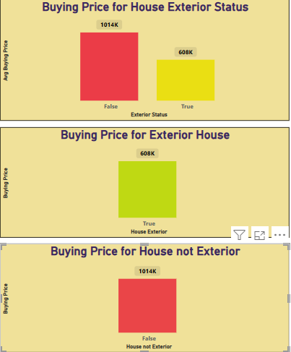
Insights from House Exterior Price Comparison Charts
Houses Without an Exterior Are More Expensive
Properties without exterior space are priced at 1.014M, whereas those with an exterior cost 608K on average.
This indicates that interior-only properties may be located in high-demand urban areas, increasing their price.
Exterior Space Lowers the Price
Homes with exterior features (gardens, patios, or outdoor space) are significantly cheaper (608K).
This could be due to location differences, with exterior houses being more common in suburban or less central areas.
Buyers Pay a Premium for Non-Exterior Homes
Some buyers may prefer compact, low-maintenance urban properties, leading to higher prices for houses without exterior spaces.
Key Takeaways for Buyers & Investors
City apartments or properties without exterior spaces tend to be more expensive, likely due to prime location advantages.
Suburban or rural homes with exterior spaces are more affordable, making them attractive for buyers seeking larger homes at lower prices.
Investment strategy should consider buyer preferences—while urban properties are costlier, they may have higher rental demand and resale value.

Slide 12
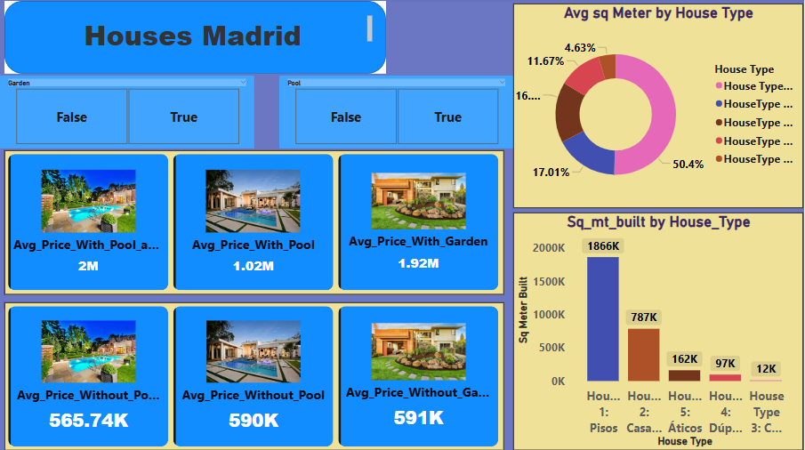

Slide 13
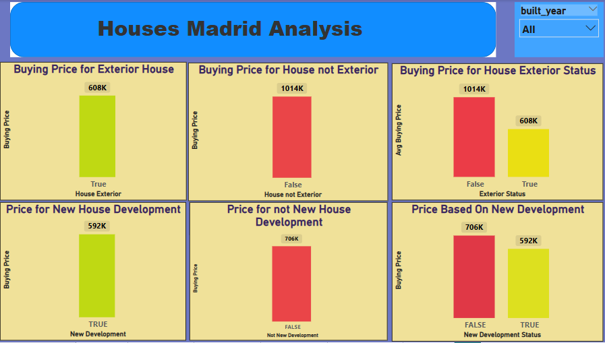

Slide 14

Conclusions
Features significantly impact property prices: Houses with pools and gardens are priced higher, while those without exterior space tend to be more expensive.
New developments are generally cheaper than older properties, indicating a possible premium on historical or well-located properties.
Pisos (apartments) dominate the market in terms of total built area, followed by Chalets, reflecting buyer preferences.
Understanding location-based price variations is crucial—urban properties (without exteriors) command a premium, while suburban houses with outdoor space offer affordability.
This dashboard provides actionable insights for real estate investors, developers, and buyers looking to maximize their investments or find the right property based on their needs.

Slide 15
Link for the video: https://www.youtube.com/watch?v=R3Cc62-eH9k
Thank you!

